Slide 1
Rain Water Trapping
Data Structures & Algorithms
Presentation By:
29_Shreerang Mhatre
63_Mukund Narsaria
66_Sarvesh Gurav
53_Aditya Vishwaraj
26_Sakshi Vetotskar

Slide 2
Index:
Introduction
Problem statement
Data Structure Used
Explanation
Infographics
Code
Results
Conclusion

Slide 3
Introduction:
DSA, or Data Structures and Algorithms, is a field of computer science that deals with the
design and implementation of efficient data structures and algorithms. While DSA may not be directly related to the physical process of trapping rainwater, it can be used to design algorithms for simulating and optimizing rainwater trapping systems.
One example of using DSA for rainwater trapping is optimizing the placement of rainwater
collection tanks in a given area. This can be modeled as a graph problem, where the nodes represent potential tank locations and the edges represent the distance between them. By using algorithms such as Dijkstra's algorithm or A* search, the optimal placement of tanks can be determined based on factors such as distance to rooftops, surface runoff areas, and stormwater drains.
Another example is using data structures such as arrays, linked lists, and stacks to efficiently store and process data from rain gauges and other sensors that measure the amount and
intensity of rainfall. This data can be used to predict the timing and quantity of rainwater runoff, which in turn can be used to optimize the size and capacity of rainwater collection systems.
In summary, DSA can be used to design and optimize rainwater trapping systems by modeling them as graph problems and efficiently processing data from sensors and other sources.

Slide 4
PROBLEM STATEMENT
Given an array of N non-negative integers arr[ ] representing an elevation map where the width of each bar is 1, compute how much water it is able to trap after raining.

Slide 5
Data Structure Used: ARRAY
An array is a data structure that can store a collection of values of the same data type, in a contiguous block of memory. It allows for efficient storage and retrieval of large amounts of data, and provides a convenient way to organize and manipulate data. In an array, each element is accessed using an index, which is an integer value that represents its position in the array. The first element is typically located at index 0, and the last element is located at index n-1, where n is the total number of elements in the array.

Slide 6
Explanation:
To compute how much water an elevation map can trap after raining, we need to first understand the problem statement and the approach we can take to solve it.
The problem states that we are given an array of N non-negative integers arr[], which represents an elevation map. We can visualize this elevation map as a set of bars of width 1, where the height of each bar represents the elevation at that point.
After raining, some water may get trapped between these bars depending on the elevation of adjacent bars. We need to compute the total amount of water that can be trapped in this way.
The approach to solve this problem is to iterate over each bar in the array, and for each bar, compute the
maximum height of the bars to its left and right. The amount of water that can be trapped at this bar is
then equal to the minimum of these maximum heights, minus the height of the current bar.
Formally, let leftMax[i] and rightMax[i] be the maximum height of the bars to the left and right of the ith bar respectively. Then, the amount of water that can be trapped at the ith bar is given by:
min(leftMax[i], rightMax[i]) - arr[i]
We can then sum up this amount for each bar to get the total amount of water that can be trapped. To compute the leftMax and rightMax arrays efficiently, we can use two passes of the array. In the first pass, we compute leftMax from left to right, and in the second pass, we compute rightMax from right to left.
The time complexity of this approach is O(N), as we only iterate over the array twice. The space complexity is also O(N), as we need to store the leftMax and rightMax arrays of size N

Slide 7
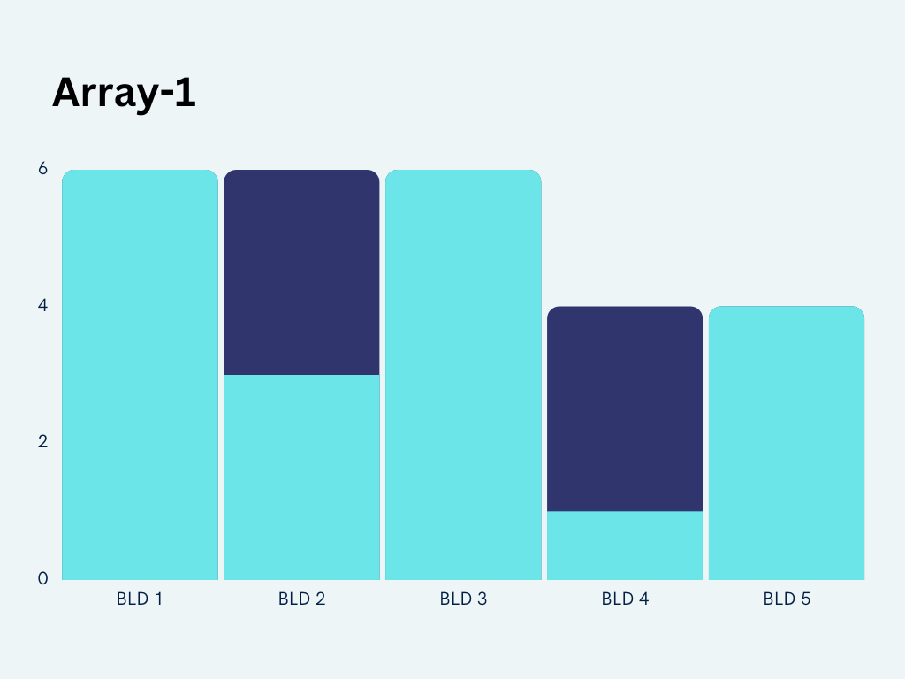
Array 1 Infographics
This graph represents array 1 i.e. set of building represented by array 1 where each element represent 1 building of width 1 unit the water that can be stored above any building is min of max height of building on the left and right minus the building self height represented in dark blue.
Note: Based on result

Slide 8
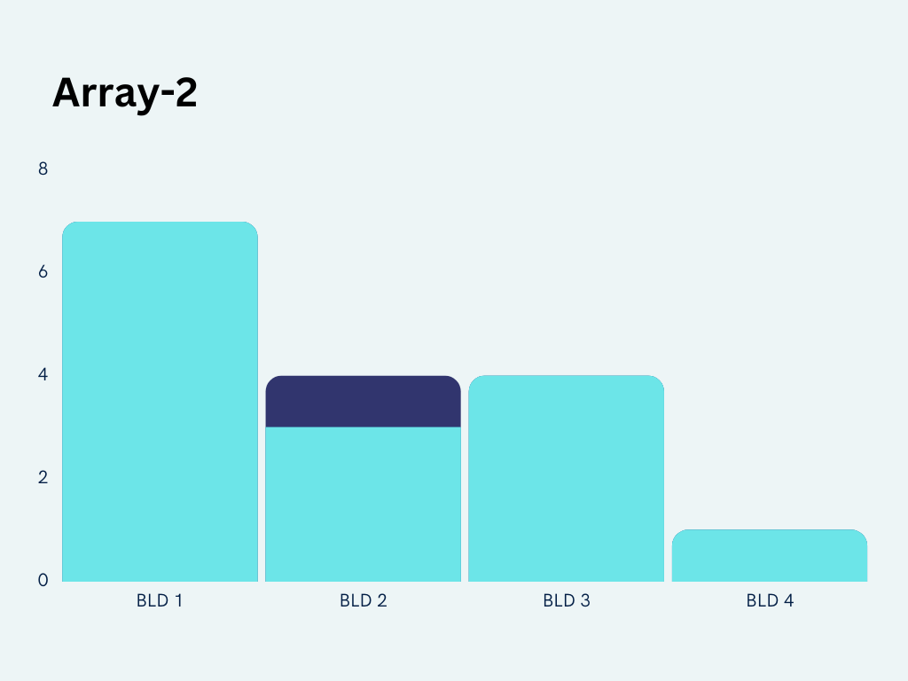
Array 2 Infographics
This graph represents array 2 i.e. set of building represented by array 2 where each element represent 1 building of width 1 unit the water that can be stored above any building is min of max height of building on the left and right minus the building self height represented in dark blue.
Note: Based on result

Slide 9
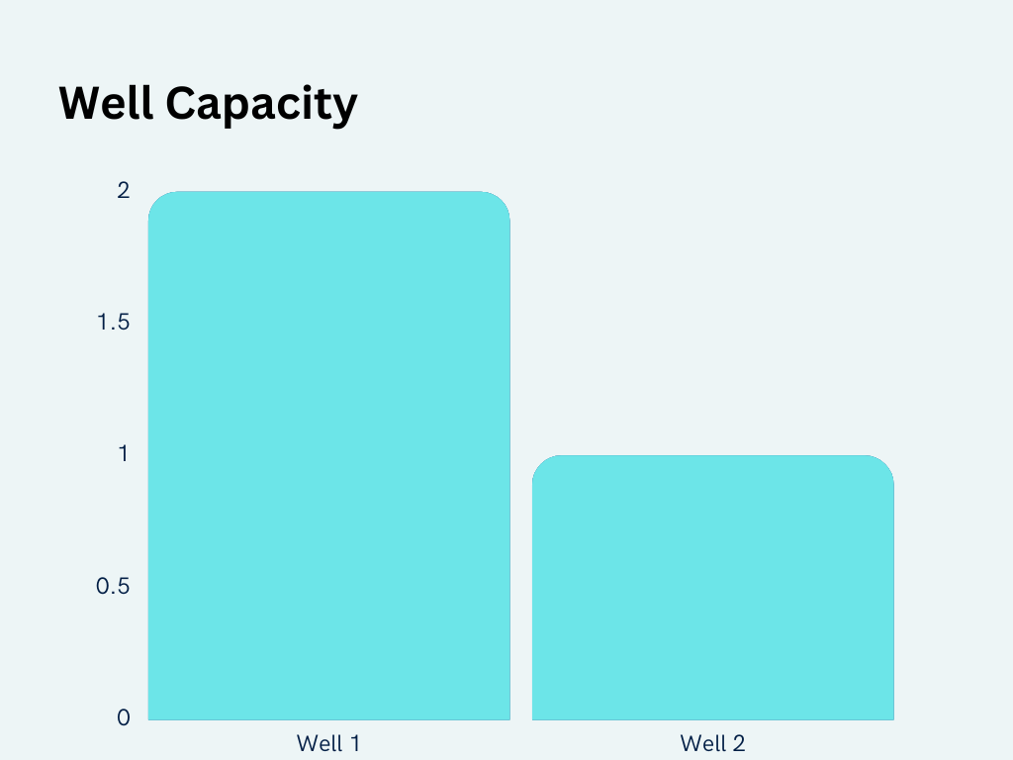
Well Infographics
The graph represents the well capacity where each element represent 1 well having width unity.
Note: Based on result

Slide 10
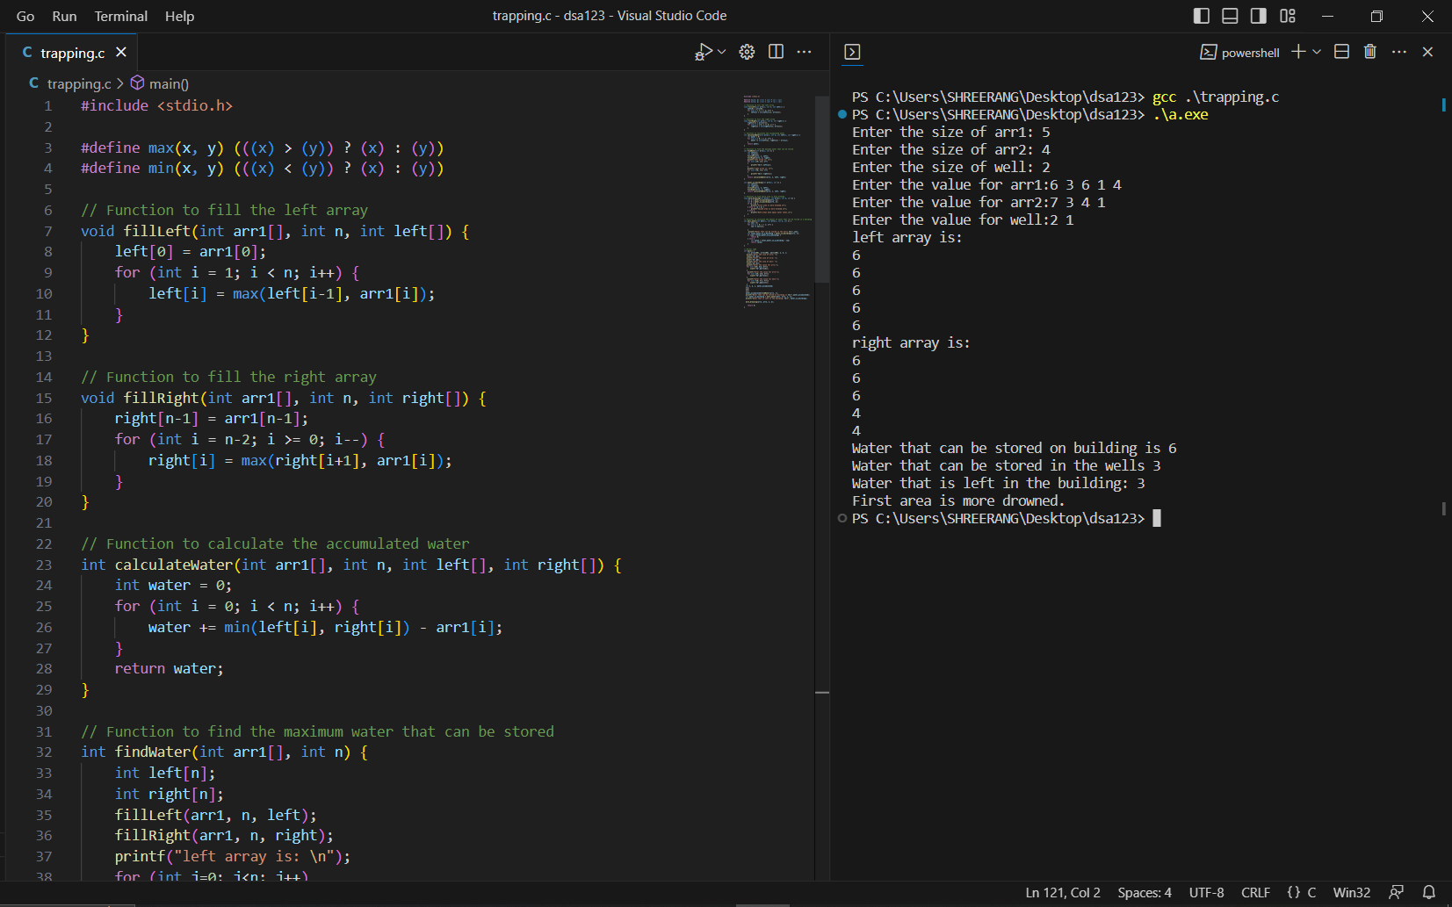
Code:

Slide 11
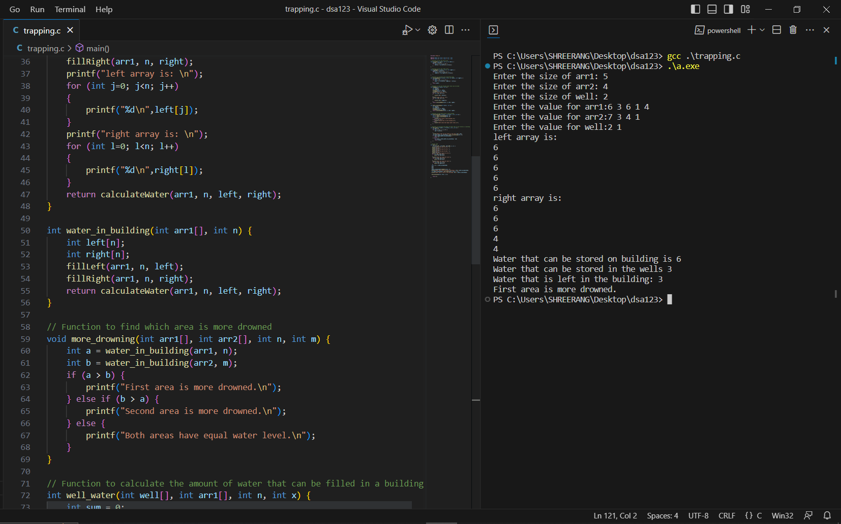
Code:

Slide 12
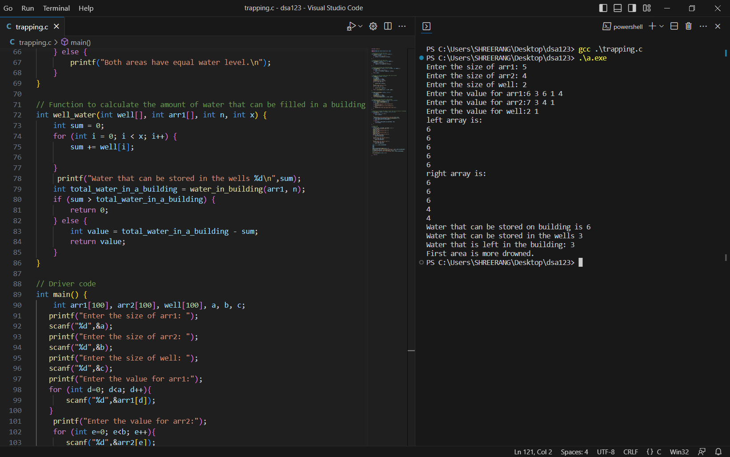
Code:

Slide 13
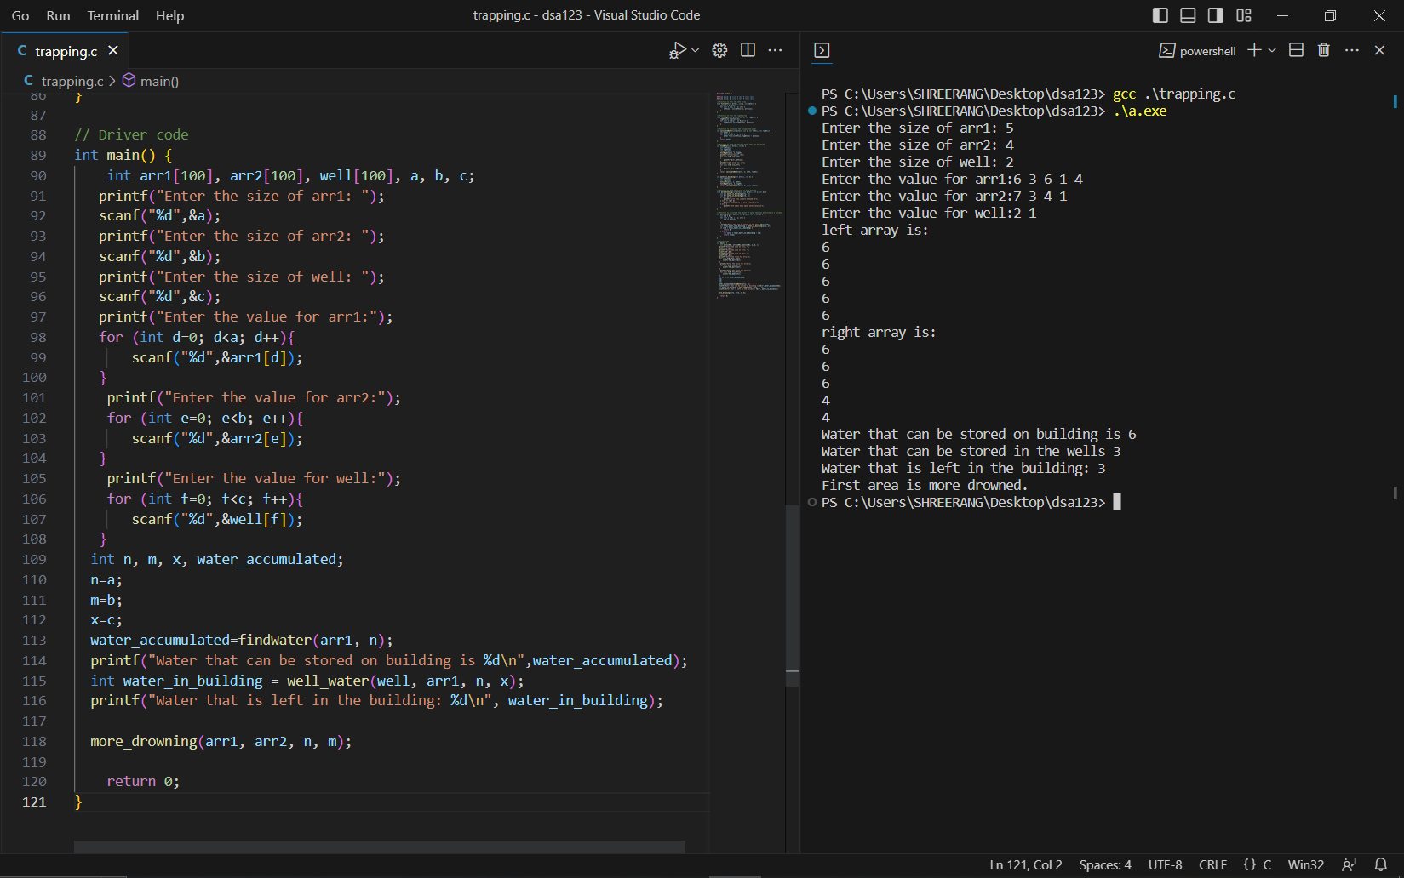
Code:

Slide 14
RESULTS:
Enter the size of arr1: 5
Enter the size of arr2: 4
Enter the size of well: 2
Enter the value for arr1:6 3 6 1 4
Enter the value for arr2:7 3 4 1
Enter the value for well:2 1
left array is: 6 6 6 6 6
right array is: 6 6 6 4 4
Water that can be stored on building is 6
Water that can be stored in the wells 3
Water that is left in the building: 3
First area is more drowned.

Slide 15
CONCLUSION:
The benefits of collecting rainwater are numerous. It reduces the demand on the municipal water supply. It allows for storage of seasonal rains for use in off-peak times. Overall, using DSA techniques to solve the rainwater trapping problem can provide an efficient and effective solution.

Slide 16
References:
https://www.geeksforgeeks.org/learn-data-structures-and-algorithms-dsa-tutorial/
https://www.programiz.com/dsa
https://www.tutorialspoint.com/data_structures_algorithms/index.htm
https://www.youtube.com/playlist?list=PL9gnSGHSqcnr_DxHsP7AW9ftq0AtAyYqJ
https://www.geeksforgeeks.org/array-data-structure/
https://www.simplilearn.com/tutorials/data-structure-tutorial/arrays-in-data-structure
https://www.javatpoint.com/data-structure-array
https://www.youtube.com/watch?v=5_5oE5lgrhw&ab_channel=CodeWithHarry
Youtube:
https://www.youtube.com/watch?v=sWDbCmvtaqo&t=3s

Slide 17
Thankyou

